Slide 1
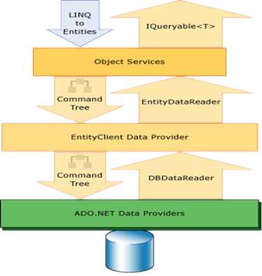
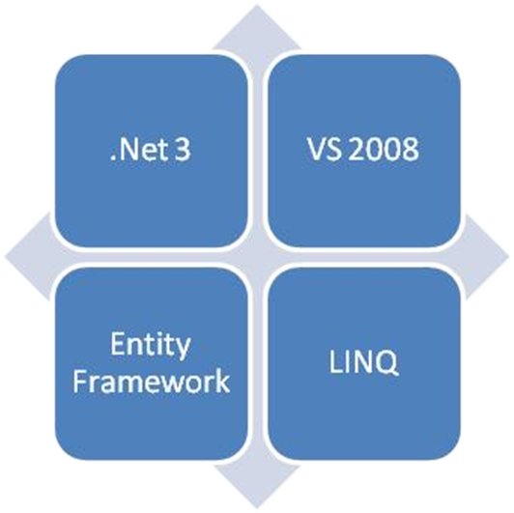
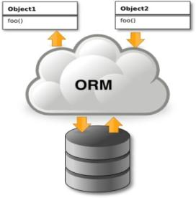

Entity Framework
ORM Concepts, Entity Framework (EF), DbContext
Telerik School Academy
Telerik Software Academy
http://academy.telerik.com

Slide 2

Table of Contents
ORM Technologies
Basic Concepts
Entity Framework
Reading Data with EF
Most used features
Create, Update, Delete using Entity Framework
Extending Entity Classes
Attaching and Detaching Objects

Slide 3
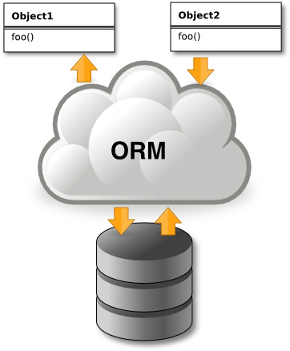
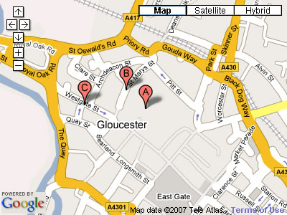


Introduction to ORM
Object-Relational Mapping (ORM) Technologies

Slide 4
ORM Technologies
Object-Relational Mapping (ORM) is a programming technique for automatic mapping and converting data
Between relational database tables and object-oriented classes and objects
ORM creates a "virtual object database"
Which can be used from within the programming language, e.g. C# or Java
ORM frameworks automate the ORM process
A.k.a. object-relational persistence frameworks

Slide 5
ORM Frameworks
ORM frameworks typically provide the following functionality:
Creating object model by database schema
Creating database schema by object model
Querying data by object-oriented API
Data manipulation operations
CRUD – create, retrieve, update, delete
ORM frameworks automatically generate SQL to perform the requested data operations

Slide 6
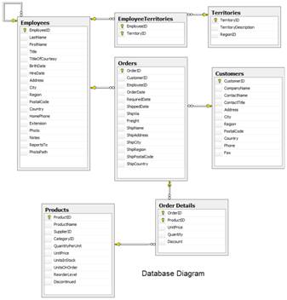
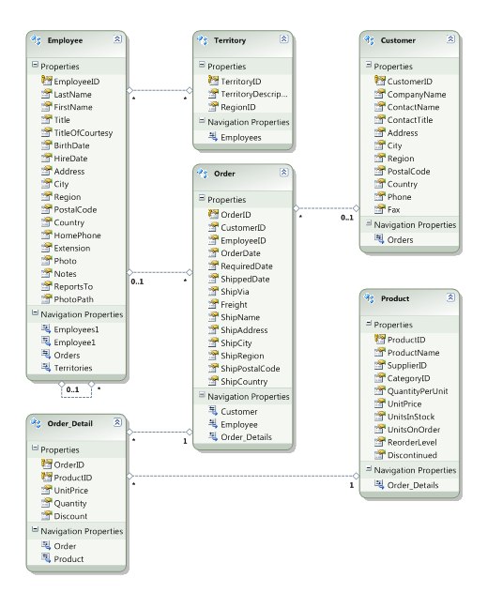




ORM Mapping – Example
Database and Entities mapping diagrams for a subset of the Northwind database
Relational database schema
ORM Entities (C# Classes)
ORM
Framework

Slide 7
ORM Advantages
Object-relational mapping advantages
Developer productivity
Writing less code
Abstract from differences between object and relational world
Complexity hidden within ORM
Manageability of the CRUD operations for complex relationships
Easier maintainability

Slide 8
ORM Frameworks in .NET
Built-in ORM tools in .NET Framework and VS
Entity Framework (LINQ-to-Entities)
LINQ-to-SQL
Both combine entity class mappings and code generation, SQL is generated at runtime
Third party ORM tools
NHibernate – the old daddy of ORM
Telerik DataAccess ORM

Slide 9


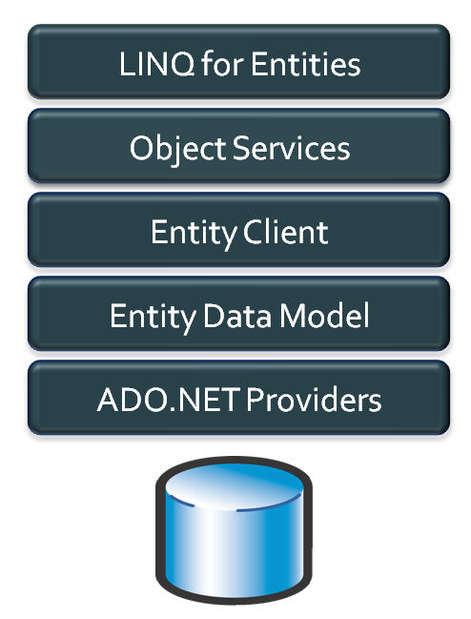
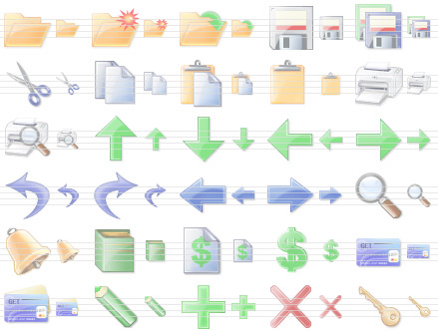
Entity Framework
Object Relation Persistence Framework

Slide 10
Overview of EF
Entity Framework (EF) is a standard ORM framework, part of .NET
Provides a run-time infrastructure for managing SQL-based database data as .NET objects
The relational database schema is mapped to an object model (classes and associations)
Visual Studio has built-in tools for generating Entity Framework SQL data mappings
Data mappings consist of C# classes and XML
A standard data manipulation API is provided

Slide 11
Entity Framework Features
Maps tables, views, stored procedures and functions as .NET objects
Provides LINQ-based data queries
Executed as SQL SELECTs on the database server (parameterized queries)
Built-in CRUD operations – Create/Read/Update/Delete
Creating or deleting the database schema
Tracks changes to in-memory objects

Slide 12
Entity Framework Features (2)
Works with any relational database with valid Entity Framework provider
Work with a visual model, database or with your own classes
Has very good default behavior
Very flexible for more granular control
Open source – independent release cycle
entityframework.codeplex.com
github.com/aspnet/EntityFramework

Slide 13
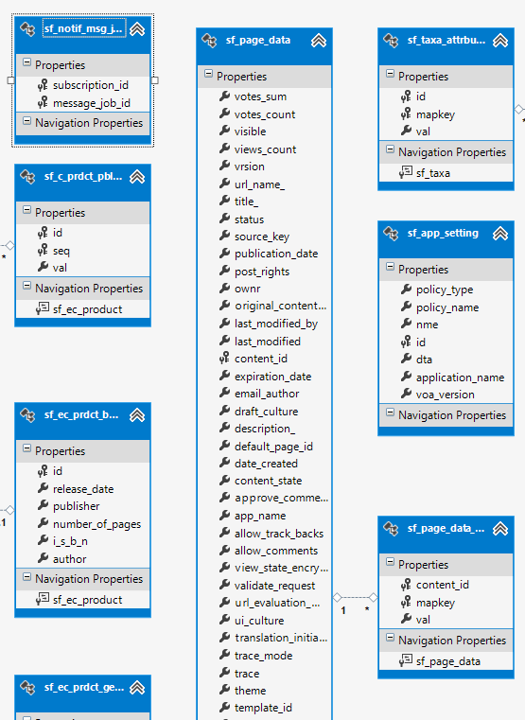
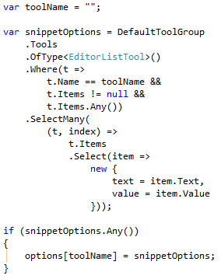
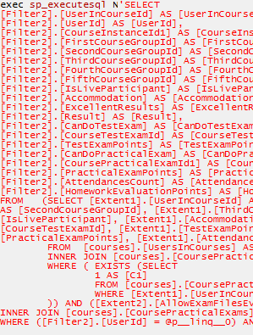
Basic Workflow
Define model
Database
Visual designer
Code
Express & execute query over IQueryable
EF determines & executes SQL query

Slide 14
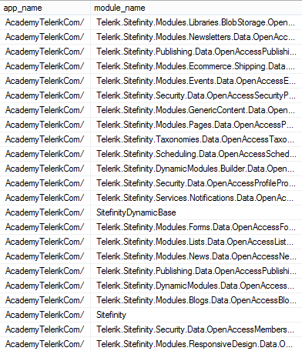
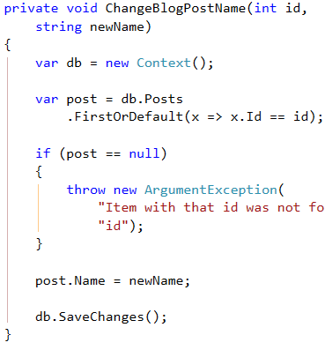
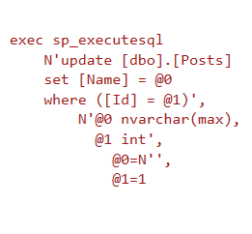
Basic Workflow (2)
EF transforms selected results into .NET objects
Modify data and call “save changes”
EF determines & executes SQL query

Slide 15
EF Components
The DbContext class
DbContext holds the database connection and the entity classes
Provides LINQ-based data access
Implements identity tracking, change tracking, and API for CRUD operations
Entity classes
Each database table is typically mapped to a single entity class (C# class)

Slide 16
EF Components (2)
Associations (Relationship Management)
An association is a primary key / foreign key based relationship between two entity classes
Allows navigation from one entity to another, e.g. Student.Courses
Concurrency control
Entity Framework uses optimistic concurrency control (no locking by default)
Provides automatic concurrency conflict detection and means for conflicts resolution

Slide 17
EF Runtime Metadata
Conceptual Model Schema
Mappings
DB
Database Structure Schema

Slide 18

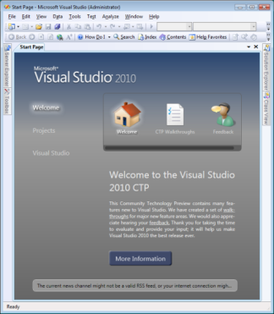

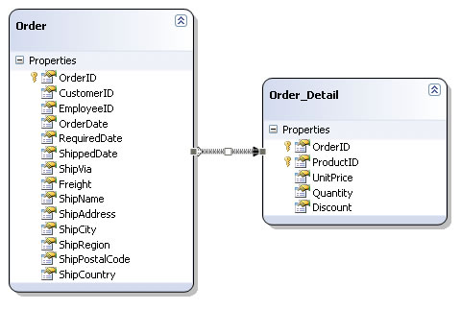
The Entity Framework Designer in Visual Studio
Live Demo

Slide 19


Reading Data with Entity Framework

Slide 20
The DbContext Class
The DbContext class is generated by the Visual Studio designer
DbContext provides:
Methods for accessing entities (object sets) and creating new entities (Add() methods)
Ability to manipulate database data though entity classes (read, modify, delete, insert)
Easily navigate through the table relationships
Executing LINQ queries as native SQL queries
Create the DB schema in the database server

Slide 21
Using DbContext Class
First create instance of the DbContext:
In the constructor you can pass a database connection string and mapping source
DbContext properties
Connection – the SqlConnection to be used
CommandTimeout – timeout for database SQL commands execution
All entity classes (tables) are listed as properties
e.g. IDbSet<Order> Orders { get; }
NorthwindEntities northwind = new NorthwindEntities();

Slide 22
Reading Data with LINQ Query
Executing LINQ-to-Entities query over EF entity:
Customers property in the DbContext:
using (var context = new NorthwindEntities())
{
var customers =
from c in context.Customers
where c.City == "London"
select c;
}
The query will be executes as SQL command in the database
public partial class NorthwindEntities : DbContext
{
public ObjectSet<Customer> Customers
{
get { … }
}
}

Slide 23
Reading Data with LINQ Query
We can also use extension methods (fluent API) for constructing the query
Find element by id
This is called
projection
using (var context = new NorthwindEntities())
{
var customerPhoness = context.Customers
.Select(c => c.Phone)
.Where(c => c.City == "London")
.ToList();
}
ToList() method executes the query
using (var context = new NorthwindEntities())
{
var customer = context.Customers.Find(2);
Console.WriteLine(customer.ContactTitle);
}

Slide 24
Logging the Native SQL Queries
To print the native database SQL commands executed on the server use the following:
var query = context.Countries;
Console.WriteLine(query.ToString());
This will print the SQL native query executed at the database server to select the Countries
Can be printed to file using StreamWriter class instead of Console class

Slide 25



Retrieving Data with LINQ to Entities
Live Demo

Slide 26


Create, Update, Delete using Entity Framework

Slide 27
Creating New Data
To create a new database row use the method Add(…) of the corresponding collection:
// Create new order object
Order order = new Order()
{
OrderDate = DateTime.Now, ShipName = "Titanic",
ShippedDate = new DateTime(1912, 4, 15),
ShipCity = "Bottom Of The Ocean"
};
// Mark the object for inserting
context.Orders.Add(order);
context.SaveChanges();
This will execute an SQL INSERT
SaveChanges() method call is required to post the SQL commands to the database

Slide 28
Cascading Inserts
We can also add cascading entities to the database:
Country spain = new Country();
spain.Name = "Spain";
spain.Population = "46 030 10";
spain.Cities.Add(new City { Name = "Barcelona"} );
spain.Cities.Add(new City { Name = "Madrid"} );
countryEntities.Countries.Add(spain);
countryEntities.SaveChanges();
This way we don't have to add each City individually
They will be added when the Country entity (Spain) is inserted to the database

Slide 29
Updating Existing Data
DbContext allows modifying entity properties and persisting them in the database
Just load an entity, modify it and call SaveChanges()
The DbContext automatically tracks all changes made on its entity objects
Order order = northwindEntities.Orders.First();
order.OrderDate = DateTime.Now;
context.SaveChanges();
This will execute an SQL UPDATE
This will execute an SQL SELECT to load the first order

Slide 30
Deleting Existing Data
Delete is done by Remove() on the specified entity collection
SaveChanges() method performs the delete action in the database
Order order = northwindEntities.Orders.First();
// Mark the entity for deleting on the next save
northwindEntities.Orders.Remove(order);
northwindEntities.SaveChanges();
This will execute an SQL DELETE command

Slide 31


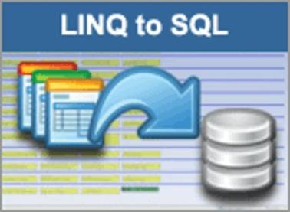


CRUD Operations with Entity Framework
Live Demo

Slide 32
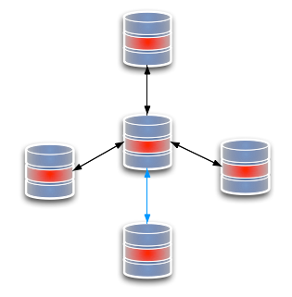
Extending Entity Classes
Add methods like ToString(), Equals(), etc…

Slide 33
Extending Entity Classes
When using “database first” or “model first” entity classes are separate .cs files that are generated by T4 tempalte XXXModel.tt
And each time we update the EntitiesModel from the database all files are generated anew
If we add methods like ToString(), they will be overridden and lost
That is why all the entity classes are "partial"
We can extend them in another file with the same partial class
When using “code first” this is not a problem

Slide 34

Extending Entity Classes
Live Demo

Slide 35

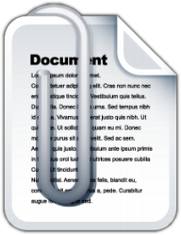
Attaching and Detaching Objects

Slide 36
Attaching and Detaching Objects
In Entity Framework, objects can be attached to or detached from an object context
Attached objects are tracked and managed by the DbContext
SaveChanges() persists all changes in DB
Detached objects are not referenced by the DbContext
Behave like a normal objects, like all others, which are not related to EF

Slide 37
Attaching Detached Objects
When a query is executed inside an DbContext, the returned objects are automatically attached to it
When a context is destroyed, all objects in it are automatically detached
E.g. in Web applications between the requests
You might later on attach to a new context objects that have been previously detached

Slide 38
Detaching Objects
When an object is detached?
When we obtain the object from an DbContext and then Dispose it
Manually: by set the entry state to Detached
Product GetProduct(int id)
{
using (NorthwindEntities northwindEntities =
new NorthwindEntities())
{
return northwindEntities.Products.First(
p => p.ProductID == id);
}
}
Now the returned product is detached

Slide 39
Attaching Objects
When we want to update a detached object we need to reattach it and then update it
Done by the Attached state of the entry
void UpdatePrice(Product product, decimal newPrice)
{
using (NorthwindEntities northwindEntities =
new NorthwindEntities())
{
var entry = northwindEntities.Entry(product);
entry.State = EntityState.Attached;
product.UnitPrice = newPrice;
northwindEntities.SaveChanges();
}
}

Slide 40



Attaching and Detaching Objects
Live Demo

Slide 41
Entity Framework
http://academy.telerik.com

Slide 42
Homework
Using the Visual Studio Entity Framework designer create a DbContext for the Northwind database
Create a DAO class with static methods which provide functionality for inserting, modifying and deleting customers. Write a testing class.
Write a method that finds all customers who have orders made in 1997 and shipped to Canada.
Implement previous by using native SQL query and executing it through the DbContext.
Write a method that finds all the sales by specified region and period (start / end dates).

Slide 43
Homework (2)
Create a database called NorthwindTwin with the same structure as Northwind using the features from DbContext. Find for the API for schema generation in MSDN or in Google.
Try to open two different data contexts and perform concurrent changes on the same records. What will happen at SaveChanges()? How to deal with it?
By inheriting the Employee entity class create a class which allows employees to access their corresponding territories as property of type EntitySet<T>.

Slide 44
Homework (3)
Create a method that places a new order in the Northwind database. The order should contain several order items. Use transaction to ensure the data consistency.
Create a stored procedures in the Northwind database for finding the total incomes for given supplier name and period (start date, end date). Implement a C# method that calls the stored procedure and returns the retuned record set.

Slide 45
Homework (4)
Create a database holding users and groups. Create a transactional EF based method that creates an user and puts it in a group "Admins". In case the group "Admins" do not exist, create the group in the same transaction. If some of the operations fail (e.g. the username already exist), cancel the entire transaction.
* Use SQL Server Profiler to view all your queries from previous homework tasks
* Download and explore the full source code of Entity Framework: http://entityframework.codeplex.com/

Slide 46




Free Trainings @ Telerik Academy
C# Programming @ Telerik Academy
csharpfundamentals.telerik.com
Telerik Software Academy
academy.telerik.com
Telerik Academy @ Facebook
facebook.com/TelerikAcademy
Telerik Software Academy Forums
forums.academy.telerik.com

